Slide 1
Introduction to Tableau
Part 8
Notes:
Welcome back to Data Society! We have a great class ahead of us today.

Slide 2
Module completion checklist
Objective | Complete
Implement table calculations with dataset
Understand addressing and partitioning fields
Explore level of detail (LOD) functions
Implement number calculations on given dataset
Implement aggregate calculations on given dataset

Slide 3
Level of Detail (LOD) functions
Level of Detail (LOD) functions give you more control over the level of granularity you want to compute.
In the world dataset we could aggregate population by:
City
Country
Region
Continent
Notes:
The purpose of this slide is to introduce the concept of Level of Detail (LOD) functions.

Slide 4
Level of Detail (LOD) function syntax
The syntax for LOD functions has curly braces.
{ keyword ([column]): aggregation function ([data column]) }
The keyword can be:
FIXED: takes into account the keyword and the dimensions in the table.
INCLUDE: only takes into account the keyword dimension.
EXCLUDE: ignores the specified dimension.
Notes:
The purpose of this slide is to WALK THROUGH the syntax for LOD functions. EXPLAIN the differences between the three operator keywords: “fixed,” “include,” and “exclude.”

Slide 5
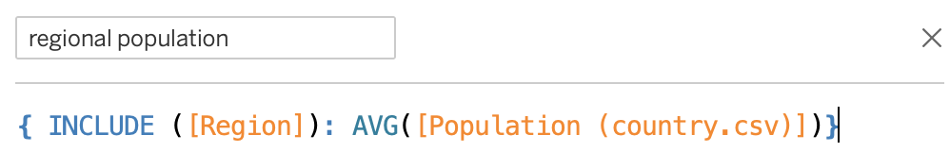
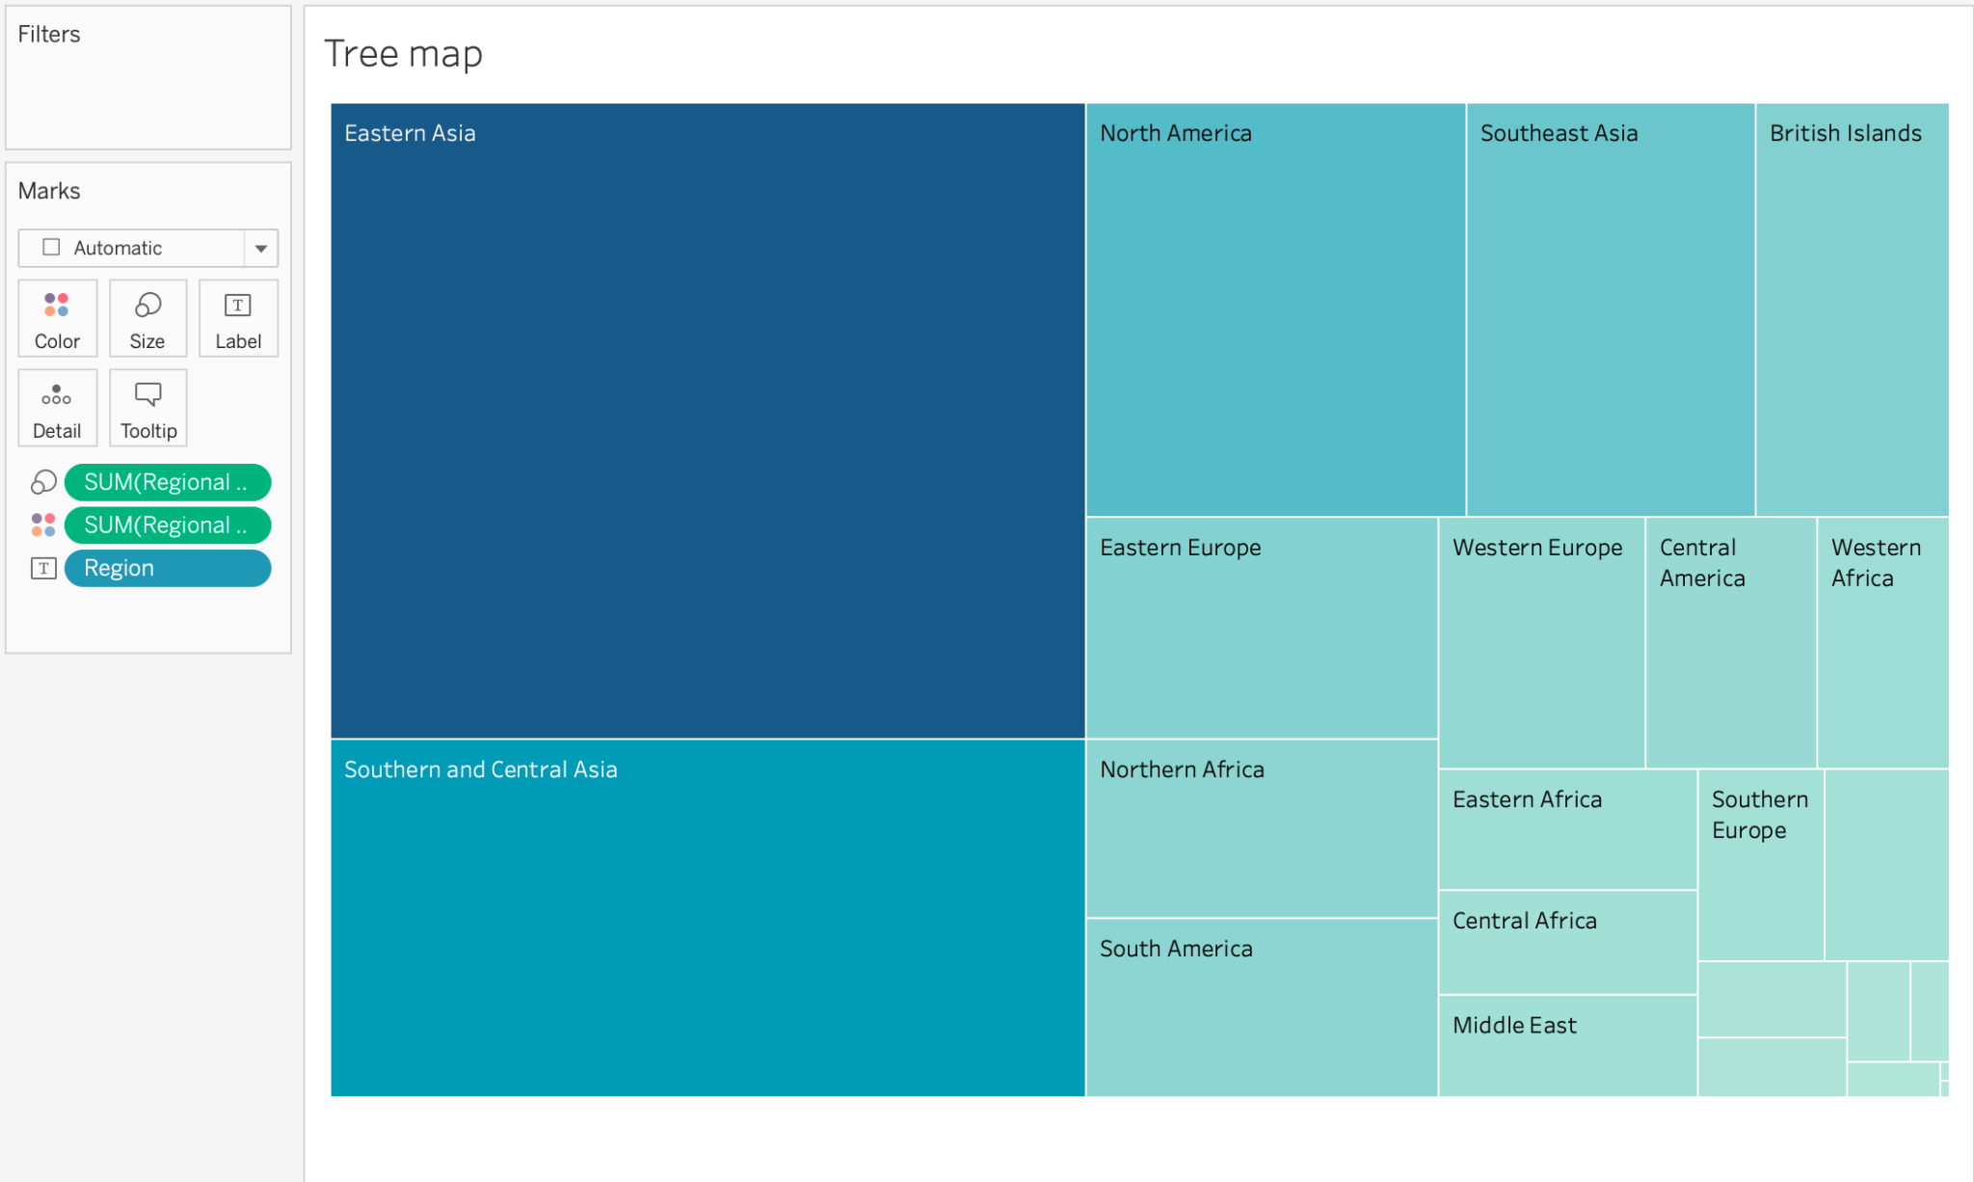
Creating a treemap with a LOD function
We will now create a treemap with population summarized at the region level.
What does this plot tell us?
Notes:
The purpose of this slide is to generate a treemap based on the average population by country, but using an LOD function to specify regional aggregation. ASK students to interpret the information as visualized and COMMENT on their responses.

Slide 6
Module completion checklist
Objective | Complete
Implement table calculations with dataset
Understand addressing and partitioning fields
Explore level of detail (LOD) functions
Implement number calculations on given dataset
Implement aggregate calculations on given dataset

Slide 7
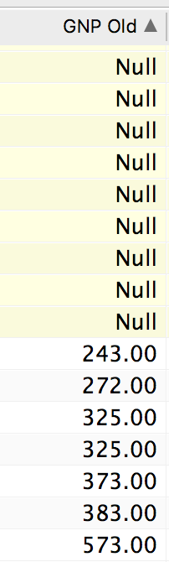
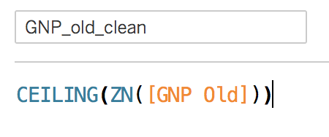
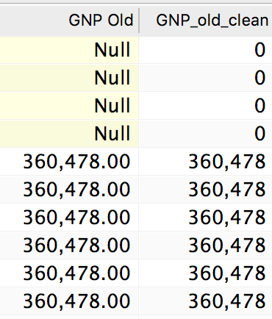
Number functions
Number functions allow you to perform computations on the data values in your fields.
They can only be used with fields that contain numerical values.
ABS(-7) = 7
ABS([Budget Variance])
We can use a number function to clean up a messy column.
Notes:
The purpose of this slide is to introduce the concept of number functions, and to suggest one use case: tidying data. EXPLAIN the operation being performed on the slide that combines the ZN() logical / number function (used to replace Null fields with 0s) with the CEILING() number function.

Slide 8
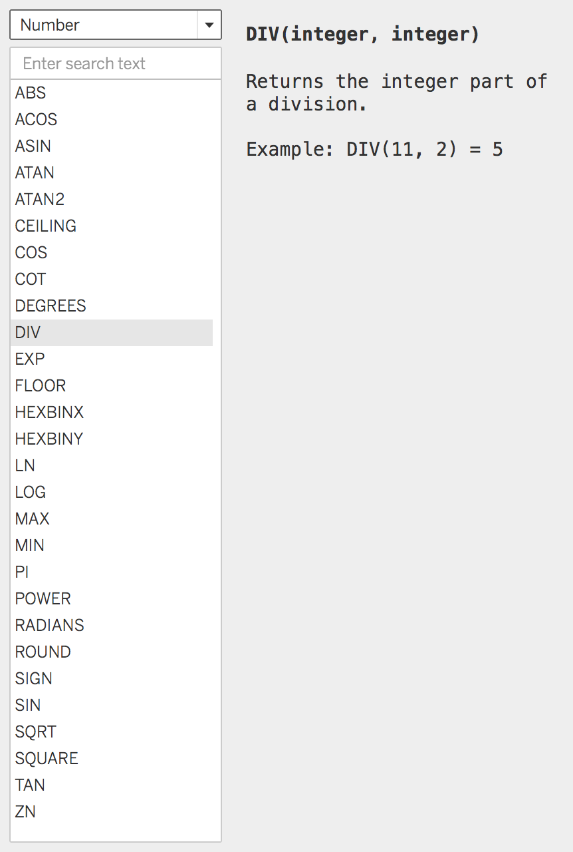
Number functions, cont’d.
Normal statistical summary and math functions are also available.
Notable functions include
Trigonometric functions.
RADIANS.
DIV for integer division.
FLOOR and CEIL.
Notes:
The purpose of this slide is to overview some of the other number functions available for computation within Tableau. Feel free to IMPROVISE and demonstrate a few of your choosing.

Slide 9
Module completion checklist
Objective | Complete
Implement table calculations with dataset
Understand addressing and partitioning fields
Explore level of detail (LOD) functions
Implement number calculations on given dataset
Implement aggregate calculations on given dataset

Slide 10
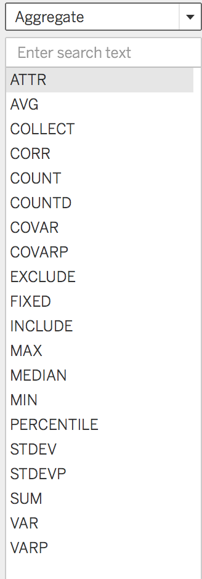
Aggregate functions
Aggregations involve a summary function, like SUM() or AVG().
The resulting function will have key built-in functions AGG() and /or ATTR().
These allow the user to conduct operations at a particular granularity.
Granularity is controlled by an attribute such as year or continent.
Notes:
The purpose of this slide is to explain how aggregate functions work in Tableau, as well as to overview the complete list. Feel free to HIGHLIGHT some particularly useful ones (i.e. VAR, COVAR) and specify a couple of limitations (COLLECT only works on geospatial data).

Slide 11
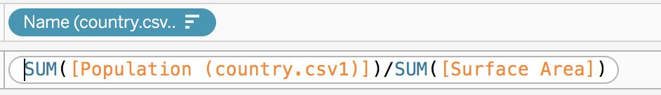
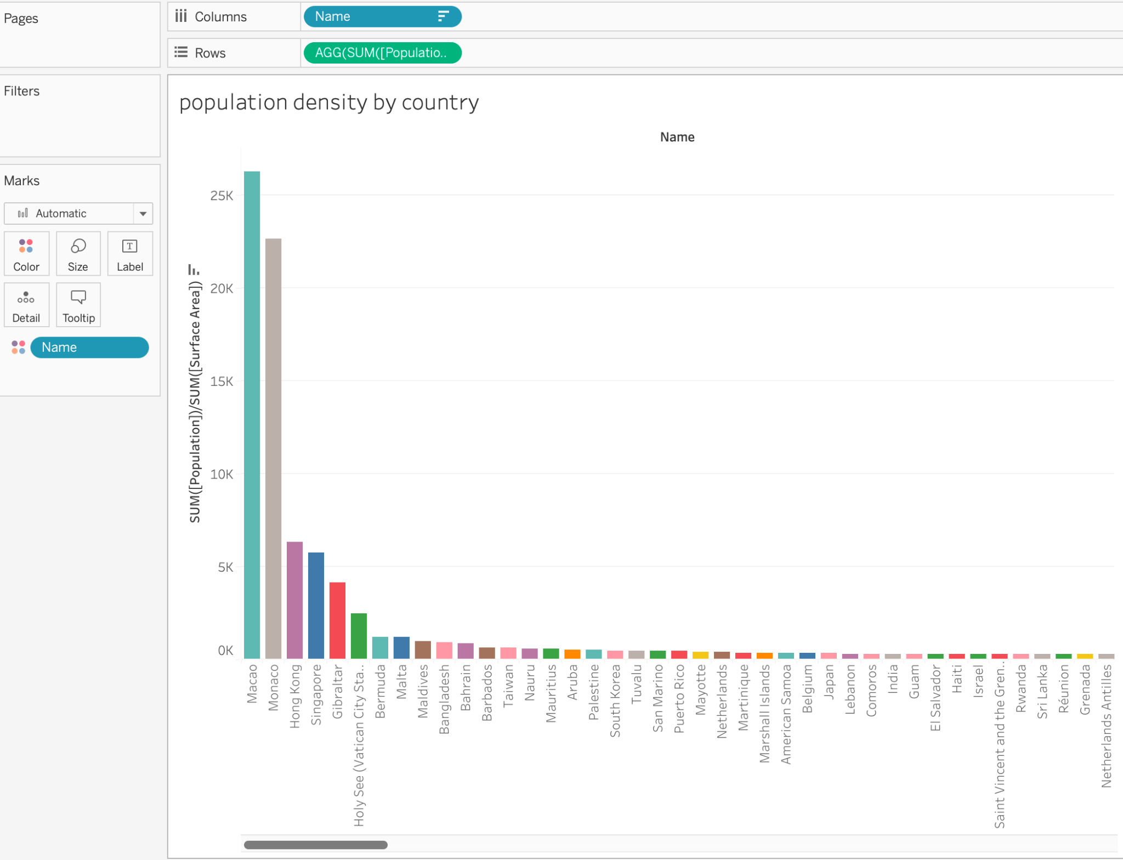
Aggregate functions
We can use AGG() to get population density by country.
Divide Population/area
Aggregate at country level
Note that the aggregate formula was added directly to the pill.
What other aggregation might we apply to our data?
Notes:
The purpose of this slide is to demonstrate how an aggregate function, SUM(), works to summarize and group the dataset. WALK THROUGH the transformation on the slide. ASK the question on the slide and COMMENT on responses.

Slide 12
Knowledge check 8

Slide 13
Exercise 8

Slide 14
Module completion checklist
Objective | Complete
Implement table calculations with dataset
Understand addressing and partitioning fields
Explore level of detail (LOD) functions
Implement number calculations on given dataset
Implement aggregate calculations on given dataset

Slide 15
Congratulations!
In the past few modules, we covered:
Functions
Table Calculations
Syntax
Addressing vs. Partitioning Fields
Level of Detail functions
Number functions
Aggregate functions
Notes:
The purpose of this slide is to review the various topics covered in class today. It is also an opportunity to ASK if students have any outstanding questions that need to be resolved.

Slide 16
Next steps
In the next few modules, we will cover:
String functions
Date functions
Type functions
Logic functions
Notes:
The purpose of this slide is to introduce the agenda for the next session. COMMENT briefly on each topic to set expectations and encourage prediction.

Slide 17
End of Part 8

